Slide 1
HORIZONTAL STRETCHES AND COMPRESSIONS

Slide 2
Lets say that we have the following graph f(x).
y
10
x
10
f(x)
Let’s graph g(x) = f (2x) .

Slide 3
y
10
x
10
g(x) = f (2x)
f(x)
Let’s find
g(– 3)
g(– 3) = f ( 2(– 3) )
= f (‒ 6)
From graph, f(– 6) = 0
Then, g(– 3) = 0
Point to graph is (– 3 , 0)

Slide 4
y
10
x
10
g(x) = f (2x)
f(x)
Let’s find
g(– 1.5)
g(– 1.5) = f ( 2(‒ 1.5) )
= f (‒ 3)
From graph, f(– 3) = 3
Then, g(– 1.5) = 3
Point to graph is (– 1.5 , 3)

Slide 5
y
10
x
10
g(x) = f (2x)
f(x)
Let’s find
g(0)
g(0) = f( 2(0) )
= f (0)
From graph, f(0) = ‒ 3
Then, g(0) = – 3
Point to graph is (0 , – 3)
Point did not move

Slide 6
y
10
x
10
g(x) = f (2x)
f(x)
Let’s find
g(3)
g(3) = f( 2(3) )
= f (6)
From graph, f(6) = 0
Then, g(3) = 0
Point to graph is (3 , 0)

Slide 7
y
10
x
10
f(x)
If g(x) = f (2x) ,
the graph of g(x) is the graph of f(x) compressed
by a factor 1/2 on the X-axis.

Slide 8
Now, lets say that we have the following graph f(x).
y
10
x
10
f(x)
Let’s graph g(x) = f ( ½ x ) .

Slide 9
y
10
x
10
g(x) = f ( ½ x )
f(x)
Let’s find
g(– 12)
g(– 12) = f ( ½ (– 12) )
= f (‒ 6)
From graph, f(– 6) = 0
Then, g(– 12) = 0
Point to graph is (– 12 , 0)

Slide 10
y
10
x
10
g(x) = f ( ½ x )
f(x)
Let’s find
g(– 6)
g(– 6) = f ( ½ (– 6) )
= f (‒ 3)
From graph, f(– 3) = 3
Then, g(– 6) = 3
Point to graph is (– 6 , 3)

Slide 11
y
10
x
10
g(x) = f ( ½ x )
f(x)
Let’s find
g(0)
g(0) = f ( ½ (0) )
= f (0)
From graph, f(0) = – 3
Then, g(0) = – 3
Point to graph is (0 , – 3)
Point did not move

Slide 12
y
10
x
10
g(x) = f ( ½ x )
f(x)
Let’s find
g(12)
g(12) = f ( ½ (12) )
= f (6)
From graph, f(6) = 0
Then, g(12) = 0
Point to graph is (12 , 0)

Slide 13
y
10
x
10
f(x)
If g(x) = f (½ x) ,
the graph of g(x) is the graph of f(x) stretched
by a factor 2 on the X-axis.

Slide 14
Conclusion
If g(x) = f (kx),
the graph of g(x) is the graph of f(x)
stretched along the x-axis by a factor of |1 / k| when |k| < 1.
or
compressed on the x-axis by a factor of |1 / k| when |k| > 1.
If k < 0, in addition to the corresponding compression
or stretch along the x-axis, reflection over the y-axis is also
involved.

Slide 15
Example 1
y
4
3
2
1
x
–4
–3
–2
–1
0
1
2
3
4
–1
f (x)
–2
–3
–4

Slide 16
y
g(x) = f (x)
4
3
2
g(x)
1
x
–4
–3
–2
–1
0
1
2
3
4
–1
f (x)
–2
–3
–4

Slide 17
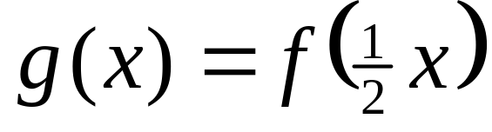
y
4
3
2
g (x)
1
x
–4
–3
–2
–1
0
1
2
3
4
–1
–2
f (x)
–3
–4

Slide 18
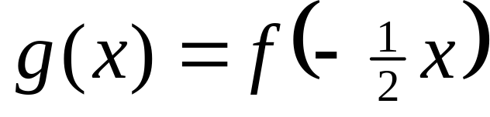
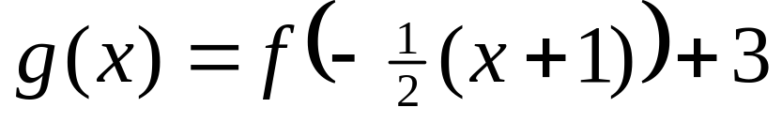
y
4
3
2
g (x)
1
x
–4
–3
–2
–1
0
1
2
3
4
–1
–2
f (x)
–3
–4

Slide 19
Example 2
y
4
3
2
1
x
–4
–3
–2
–1
0
1
2
3
4
–1
f (x)
–2
–3
–4

Slide 20
y
g(x) = f (x)
4
3
2
g(x)
1
x
–4
–3
–2
–1
0
1
2
3
4
–1
f (x)
–2
–3
–4

Slide 21
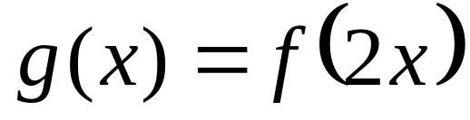
y
4
3
2
g (x)
1
x
–4
–3
–2
–1
0
1
2
3
4
–1
f (x)
–2
–3
–4

Slide 22
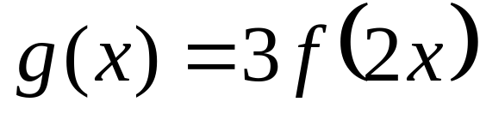
y
4
3
2
g (x)
1
x
–4
–3
–2
–1
0
1
2
3
4
–1
f (x)
–2
–3
–4

Slide 23
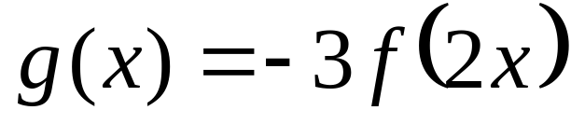
y
4
3
2
g (x)
1
x
–4
–3
–2
–1
0
1
2
3
4
–1
f (x)
–2
–3
–4

Slide 24
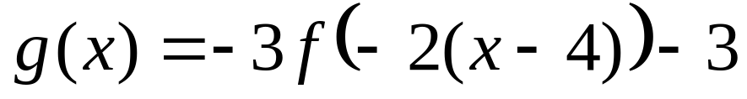
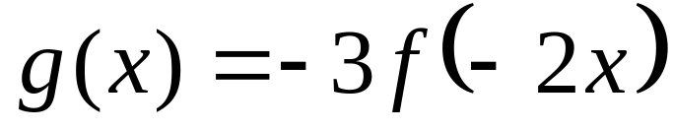
y
4
3
2
g (x)
1
x
–4
–3
–2
–1
0
1
2
3
4
–1
f (x)
–2
–3
–4

Slide 25

Example 3
If
, find A, B, h, and k.
y
4
3
g (x)
2
f (x)
1
x
–4
–3
–2
–1
0
1
2
3
4
–1
–2
–3
–4

Slide 26
Note
When trying to find equation of a transformed graph g(x), modify the original
graph f(x) by applying needed transformations, one by one, to finally make it look
exactly like the graph of g(x).
Apply the transformations in the following order:
1) If needed, compress or stretch f(x) along the y-axis by a factor |A|.
2) If needed, reflect graph about the x-axis.
Then, you would have defined the sign of parameter A.
3) If needed, compress or stretch graph along the x-axis by a factor |1/B|.
4) If needed, reflect graph about the y-axis.
Then, you would have defined the sign of parameter B.
5) If needed, translate the graph h units to right or left.
6) If needed, translate the graph k units up or down.
7) Then,

Slide 27
Example 3
If
, find A, B, h, and k.
y
4
Let’s modify the
graph of f(x) to
make it look exactly
like the graph
of g(x).
3
g (x)
2
f (x)
1
x
–4
–3
–2
–1
0
1
2
3
4
–1
–2
–3
–4

Slide 28
f(x) stretched along
y-axis by a factor of 2.
y
4
Then |A| = 2.
3
g (x)
2
1
x
–4
–3
–2
–1
0
1
2
3
4
–1
–2
–3
–4

Slide 29
f(x) stretched along
y-axis by a factor of 2.
y
4
Then |A| = 2.
Reflection about x-axis.
3
g (x)
Then, A = – 2.
2
1
x
–4
–3
–2
–1
0
1
2
3
4
–1
–2
–3
–4

Slide 30
f(x) stretched along
y-axis by a factor of 2.
y
4
Then |A| = 2.
Reflection about x-axis.
3
g (x)
Then, A = – 2.
2
Compression along
x-axis by a factor of ½.
1
x
Then, |B| = 2.
–4
–3
–2
–1
0
1
2
3
4
No reflection about
y-axis.
–1
Then, B = 2.
–2
x-Translation: 3 to right.
–3
Then, h = 3.
y-Translation: 1 up.
–4
Then, k = 1.

Slide 31
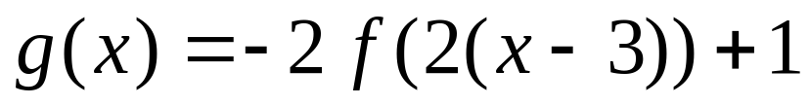
Answer:
y
4
3
g (x)
2
f (x)
1
x
–4
–3
–2
–1
0
1
2
3
4
–1
–2
–3
–4

Slide 32
y
10
Example 4
f(x)
10
x
g(x)
If
, find A, B, h, and k.

Slide 33
y
f(x) stretched along
y-axis by a factor of 4.
10
Then |A| = 4.
10
x
g(x)

Slide 34
y
f(x) stretched along
y-axis by a factor of 4.
10
Then |A| = 4.
Reflection about x-axis.
Then, A = – 4.
10
x
g(x)

Slide 35
y
f(x) stretched along
y-axis by a factor of 4.
10
Then |A| = 4.
Reflection about x-axis.
Then, A = – 4.
Stretch along
x-axis by a factor of 3.
10
x
Then, |B| = 1/3
g(x)

Slide 36
y
f(x) stretched along
y-axis by a factor of 4.
10
Then |A| = 4.
Reflection about x-axis.
Then, A = – 4.
Stretch along
x-axis by a factor of 3.
10
x
Then, |B| = 1/3
Reflection about y-axis.
Then, B = – 1/3
g(x)

Slide 37
y
f(x) stretched along
y-axis by a factor of 4.
10
Then |A| = 4.
Reflection about x-axis.
Then, A = – 4.
Stretch along
x-axis by a factor of 3.
10
x
Then, |B| = 1/3
Reflection about y-axis.
Then, B = – 1/3
g(x)
x-Translation: 4 to left.
Then, h = – 4

Slide 38
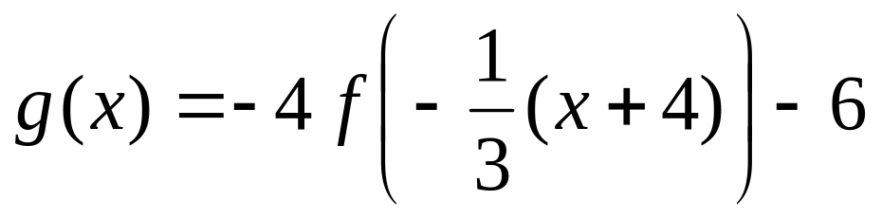
y
f(x) stretched along
y-axis by a factor of 4.
10
Then |A| = 4.
Reflection about x-axis.
Then, A = – 4.
Stretch along
x-axis by a factor of 3.
f(x)
10
x
Then, |B| = 1/3
Reflection about y-axis.
Then, B = – 1/3
g(x)
x-Translation: 4 to left.
Then, h = – 4
y-Translation: 6 down.
Answer:
Then, k = – 6

Slide 39
Example 5
Enumerate the transformations ( in correct order) applied to f(x) to obtain
the graph of g(x) = 2f(x) + 3.
Solution
Let h(x) = 2f(x)
Then, to obtain h(x), f(x) was stretched vertically by a factor of 2.
Let g(x) = h(x) + 3
Then, to obtain g(x), h(x) was translated 3 units up.
Because g(x) = h(x) + 3 and h(x) = 2f(x)
→ g(x) = 2f(x) + 3
Therefore, to obtain g(x), f(x) was stretched vertically by a factor of 2
and then translated 3 unit up.

Slide 40
Example 6
Enumerate the transformations ( in correct order) applied to f(x) to obtain
the graph of g(x) = 2 [ f(x) + 3 ].
Solution
Let h(x) = f(x) + 3
Then, to obtain h(x), f(x) was translated up 3 units.
Let g(x) = 2h(x)
Then, to obtain g(x), h(x) was stretched vertically by a factor of 2.
Because g(x) = 2h(x) and h(x) = f(x) + 3
→ g(x) = 2 [ f(x) + 3 ]
Therefore, to obtain g(x), f(x) was translated up 3 units and
then stretched vertically by a factor of 2.

Slide 41
Example 7
Enumerate the transformations ( in correct order) applied to f(x) to obtain
the graph of g(x) = f(2x + 3)
Solution
Let h(x) = f(x + 3)
Then, to obtain h(x), f(x) was translated 3 units to the left.
Let g(x) = h(2x).
Then, to obtain g(x), h(x) was compressed horizontally by a factor of ½.
Because g(x) = h(2x) and h(2x) = f(2x + 3)
→ g(x) = f(2x + 3)
Therefore, to obtain g(x), f(x) was translated 3 to the left and
then compressed horizontally by a factor of 1/2.

Slide 42
Example 8
Enumerate the transformations ( in correct order) applied to f(x) to obtain
the graph of g(x) = f [ 2(x + 3) ]
Solution
Let h(x) = f (2x)
Then, to obtain h(x), f(x) was compressed horizontally by a factor of ½.
Let g(x) = h(x + 3).
Then, to obtain g(x), h(x) was translated to the left 3 units.
Because g(x) = h(x + 3) and h(x + 3) = f [ 2(x + 3) ]
→ g(x) = f [ 2(x + 3) ]
Therefore, to obtain g(x), f(x) was compressed horizontally by a factor
of ½ and then translated horizontally 3 units to left.

